Slide 1
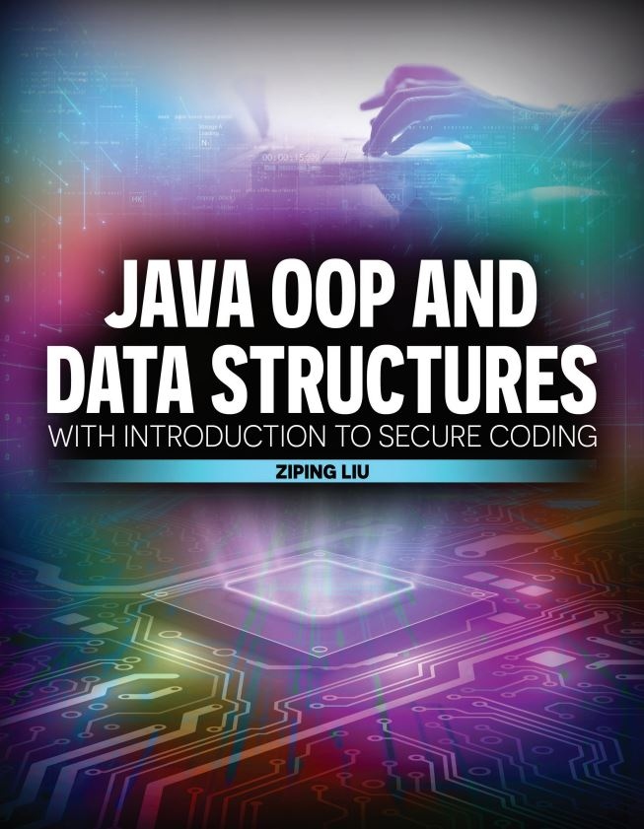

Slide 2

Java OOP and Data Structures with Introduction to Secure Coding Dr. Ziping Liu
Chapter 13 Queue

Slide 3
https://he.kendallhunt.com/product/java-oop-and-data-structures-introduction-secure-coding
Chapter 13 Queue

Slide 4

Chapter Outlines
What is a queue?
Implementing a capacity-bounded queue
using a linear array
using a circular array
Working with queues in Java Collections
A simulation of lines in check-out lanes (available on the supplemental website)

Slide 5
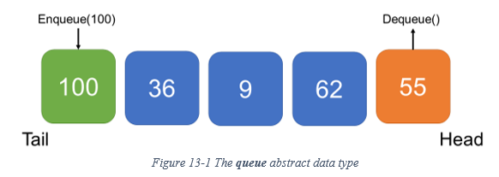
13.1 What is a Queue?
an Abstract Data Type (ADT) that represents an ordered collection of data items
are accessible at both ends, the front (or “head”) and back (or “tail”).
maintain FIFO (“first in, first out”) ordering, adds items at back and removes items at front
enqueue—adds an item at the back of the collection, and
dequeue—removes the frontmost item from the collection if the queue is not empty
Applications: customer service lines, computer I/O buffers, printing tasks, CPU scheduling, etc

Slide 6
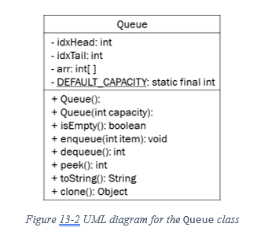
13.2 Implementing a Capacity-Bounded Queue

Slide 7
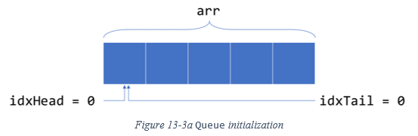
13.2 Implementing a Capacity-Bounded Queue
Linear Array Queue Implementation
seven integer numbers: 29, 51, 308, 65, 155, 78, and 81

Slide 8
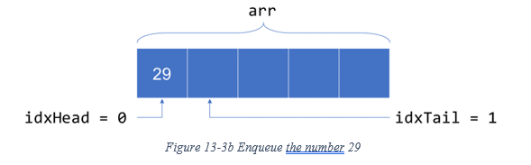
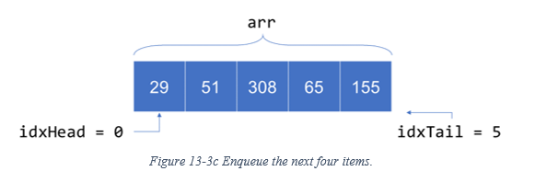
13.2 Implementing a Capacity-Bounded Queue
Linear Array Queue Implementation
idxTail does NOT point to the index of the last element, but rather, the index of the next available empty slot after the last element

Slide 9
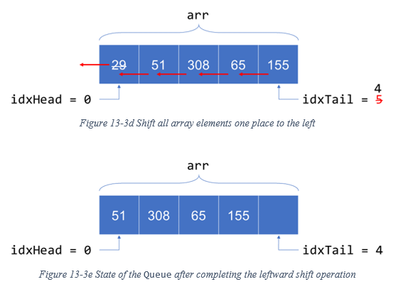
13.2 Implementing a Capacity-Bounded Queue
Linear Array Queue Implementation
dequeue 29

Slide 10
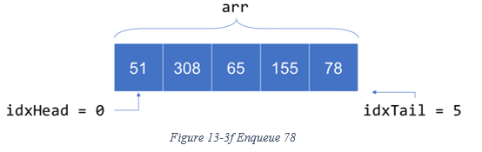
13.2 Implementing a Capacity-Bounded Queue
Linear Array Queue Implementation
enqueue 78, Queue becomes full once more
dequeue 51, all remaining elements need leftward shifting
deque 308, all remaining elements need leftward shifting

Slide 11
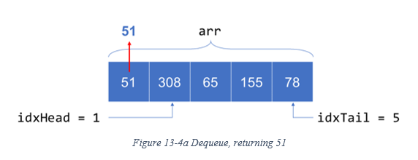
13.2 Implementing a Capacity-Bounded Queue
Linear Array Queue Implementation
An alternative would be to update idxHead when dequeuing elements instead of keeping it at zero.

Slide 12
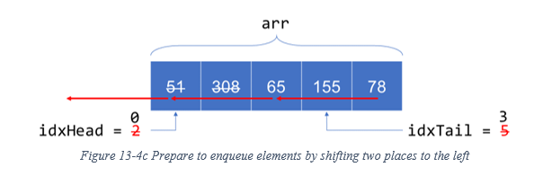
13.2 Implementing a Capacity-Bounded Queue
Linear Array Queue Implementation
Enqueue 81: need to first shift all queue elements to the left by a number of spaces equal to the value of idxHead
cannot avoid repeated leftward shift operations. Thus, the simple linear array is not the most efficient data structure to use when implementing the queue ADT

Slide 13


Slide 14


Slide 15
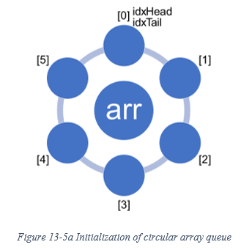
13.2 Implementing a Capacity-Bounded Queue
Circular Array Queue Implementation
A circular array is a ring that connects end-to-end, so that the “first” element can start anywhere on the ring and all ensuing elements follow going around the ring.
Circular arrays allow us to avoid the shifting operations
The size of the circular array needs to be exactly one larger than the capacity of the queue

Slide 16
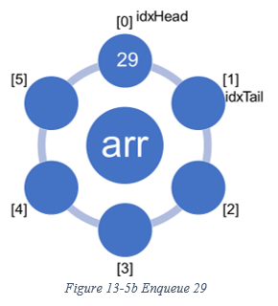
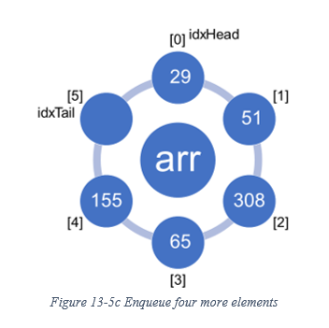
13.2 Implementing a Capacity-Bounded Queue
Circular Array Queue Implementation
enqueue till full: the queue is full because the next increment of idxTail would be equal to idxHead.
each time we enqueue an item to a non-full queue, set arr[idxTail] = item and then update the tail index idxTail := (idxTail + 1) % length, where length is the size of the circular array

Slide 17
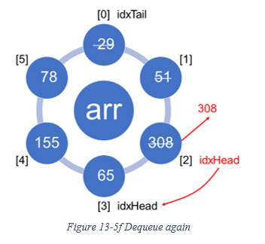
13.2 Implementing a Capacity-Bounded Queue
Circular Array Queue Implementation
Dequeue: from a non-empty capacity-bounded queue, first return the element arr[idxHead]; then update idxHead := (idxHead + 1) % length

Slide 18
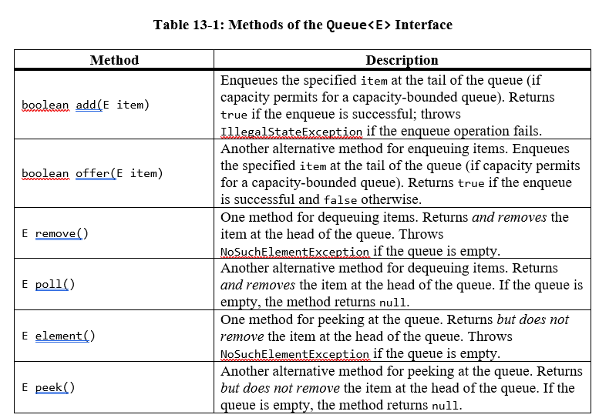
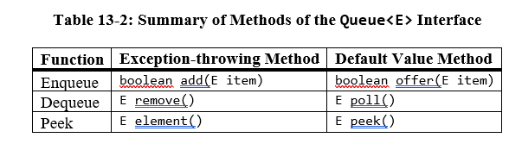
13.2 Implementing a Capacity-Bounded Queue
The Queue in Java Collections

Slide 19
13.2 Implementing a Capacity-Bounded Queue
The Queue in Java Collections
instantiate an instance of Queue: use any subclass that implements the Queue<E> interface

Slide 20
Which National Park is it?
Answer: Indiana Dunes National Park

